Slide 1
CANTEEN MANAGEMENT SYSTEM
WEB FRAMEWORKS PROJECT
Made By: Akanksha Tonne , Bhavna Arora , Athira AD

Slide 2
DESCRIPTION
The Website aims to ease the process the of ordering food from canteens in the college
The website has the following Applications:
Shopkeeper
Shop(For the person who comes to shop)
Cart(To find the bill of the purchased items during the session)
The models are:
Categories (like Beverages, Chaats, Chinese)
Items

Slide 3
DESCRIPTION
The website uses Django sessions and user defined context pre-processor for the ‘Cart’ Application to save all the items in the current session and gets deleted after the user logs out.
The Django project uses ImageField Attribute in the ‘Item’ model, which requires the pillow library which needs to be installed(using pip install pillow).
Every shopkeeper must login with username starting with ‘shop’
Any user who is not logged in and tries to manually edit the URL in browser’s tab is redirected to the homepage.

Slide 4
DETAILS
Link to repository https://github.com/Akanksha-Tonne/Webframeworks-Cateen-Management-System.git

Slide 5
TAKEAWAYS
Learnt to make a complete Django project from scratch with all basic working functionalities using Django sessions.

Slide 6
CHALLENGES
Using Django sessions to store the currently selected items in the cart
Using Class Based Views to display templates
Adding a common style to all apps in the project

Slide 7
CONTRIBUTIONS
Akanksha : combining all the applications, applying css, debugging
Bhavna: cart, shop applications
Athira: shopkeeper application, login pages

Slide 8
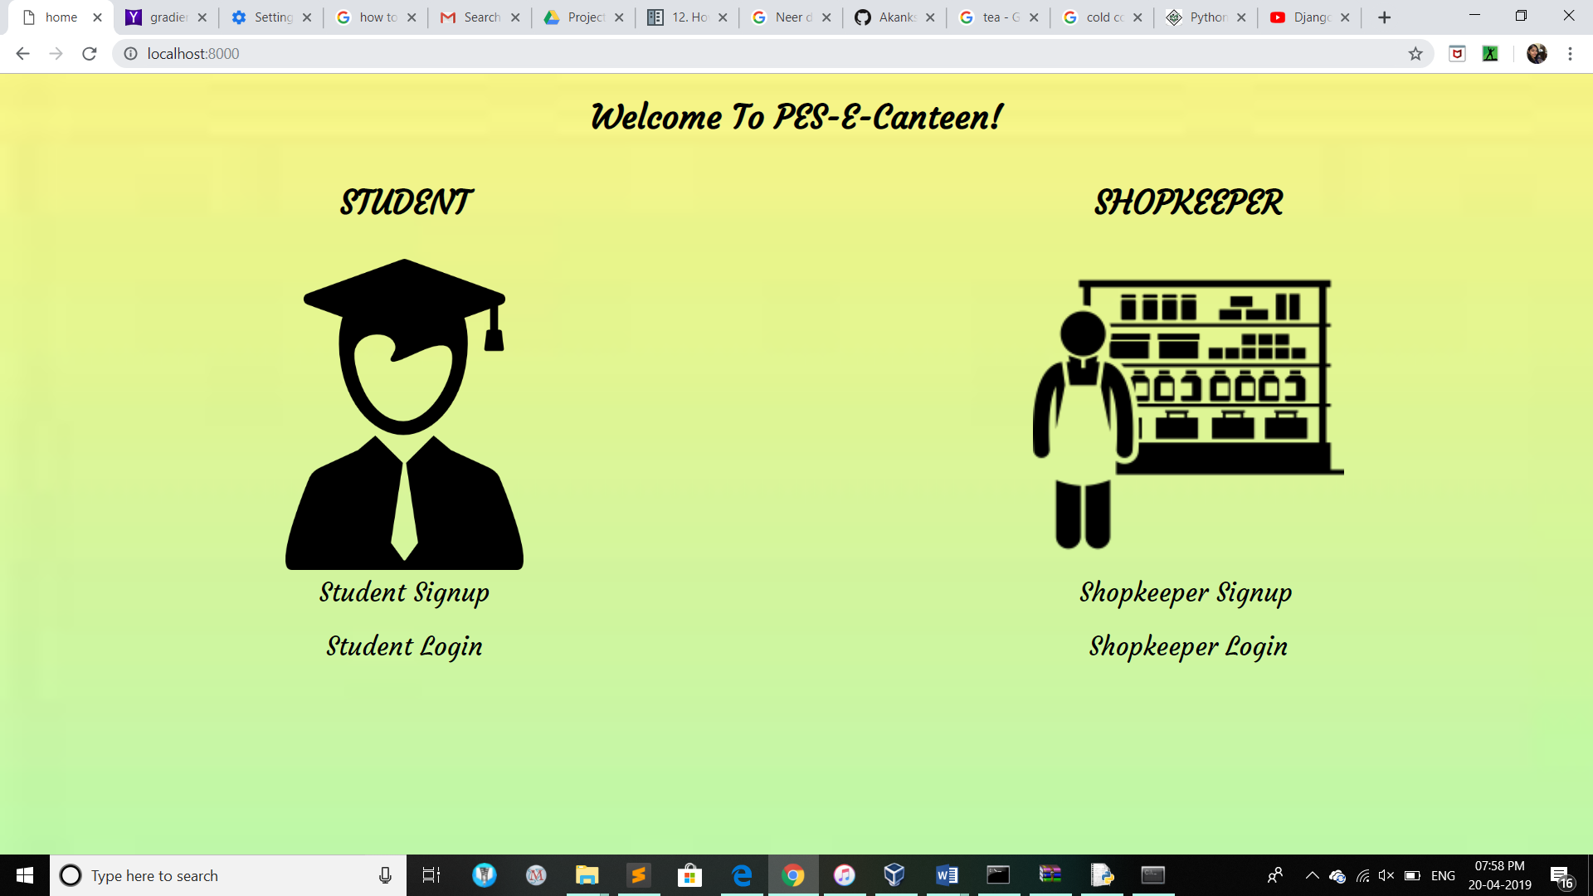
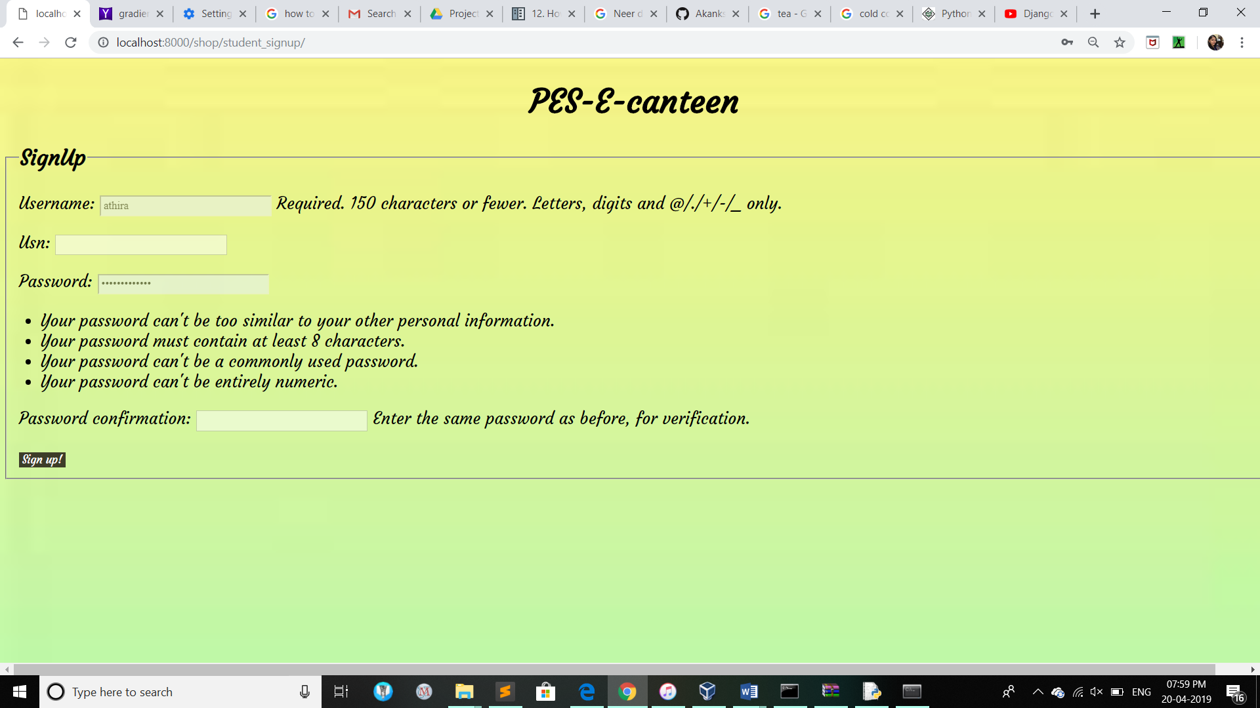
SCREENSHOTS OF THE PROJECT

Slide 9
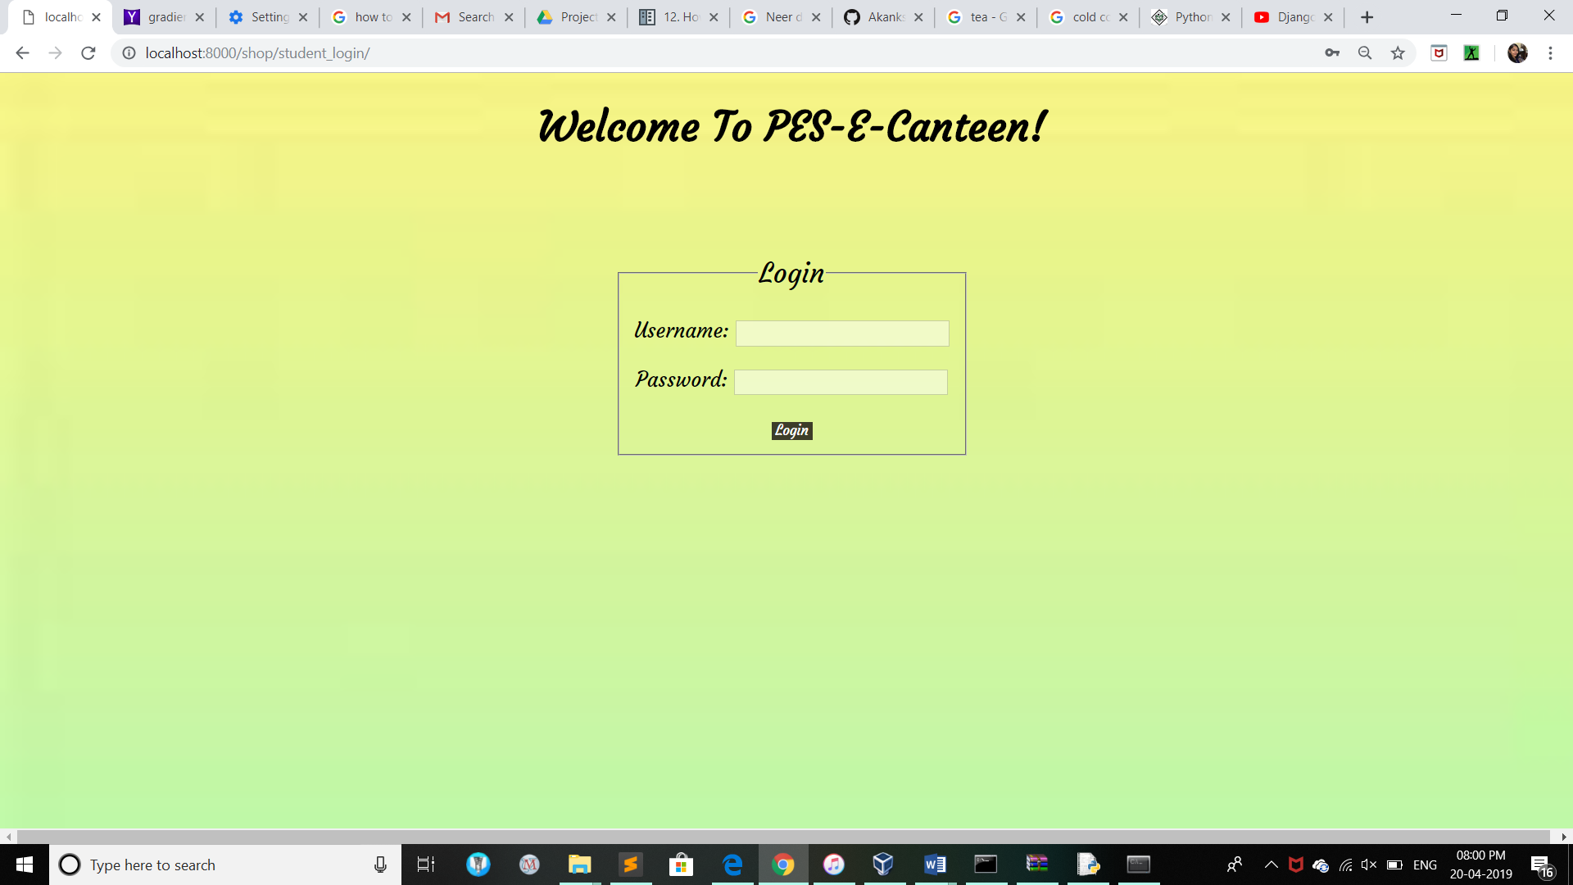
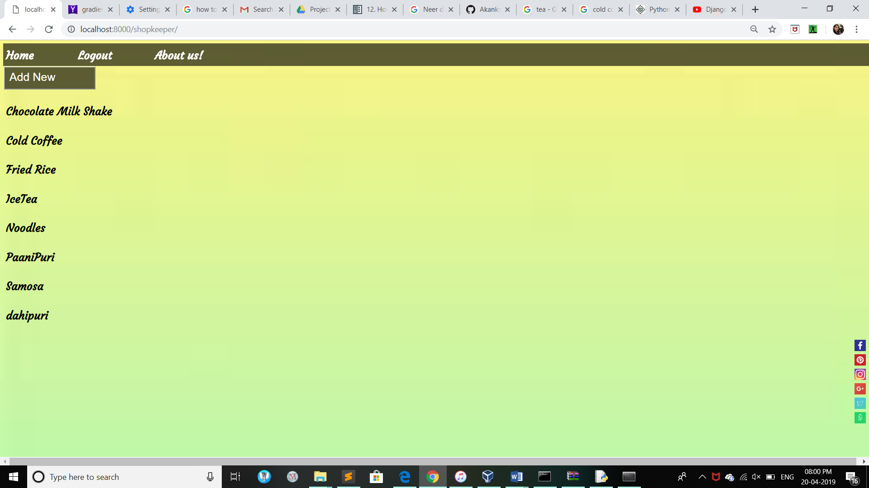
SCREENSHOTS OF THE PROJECT

Slide 10
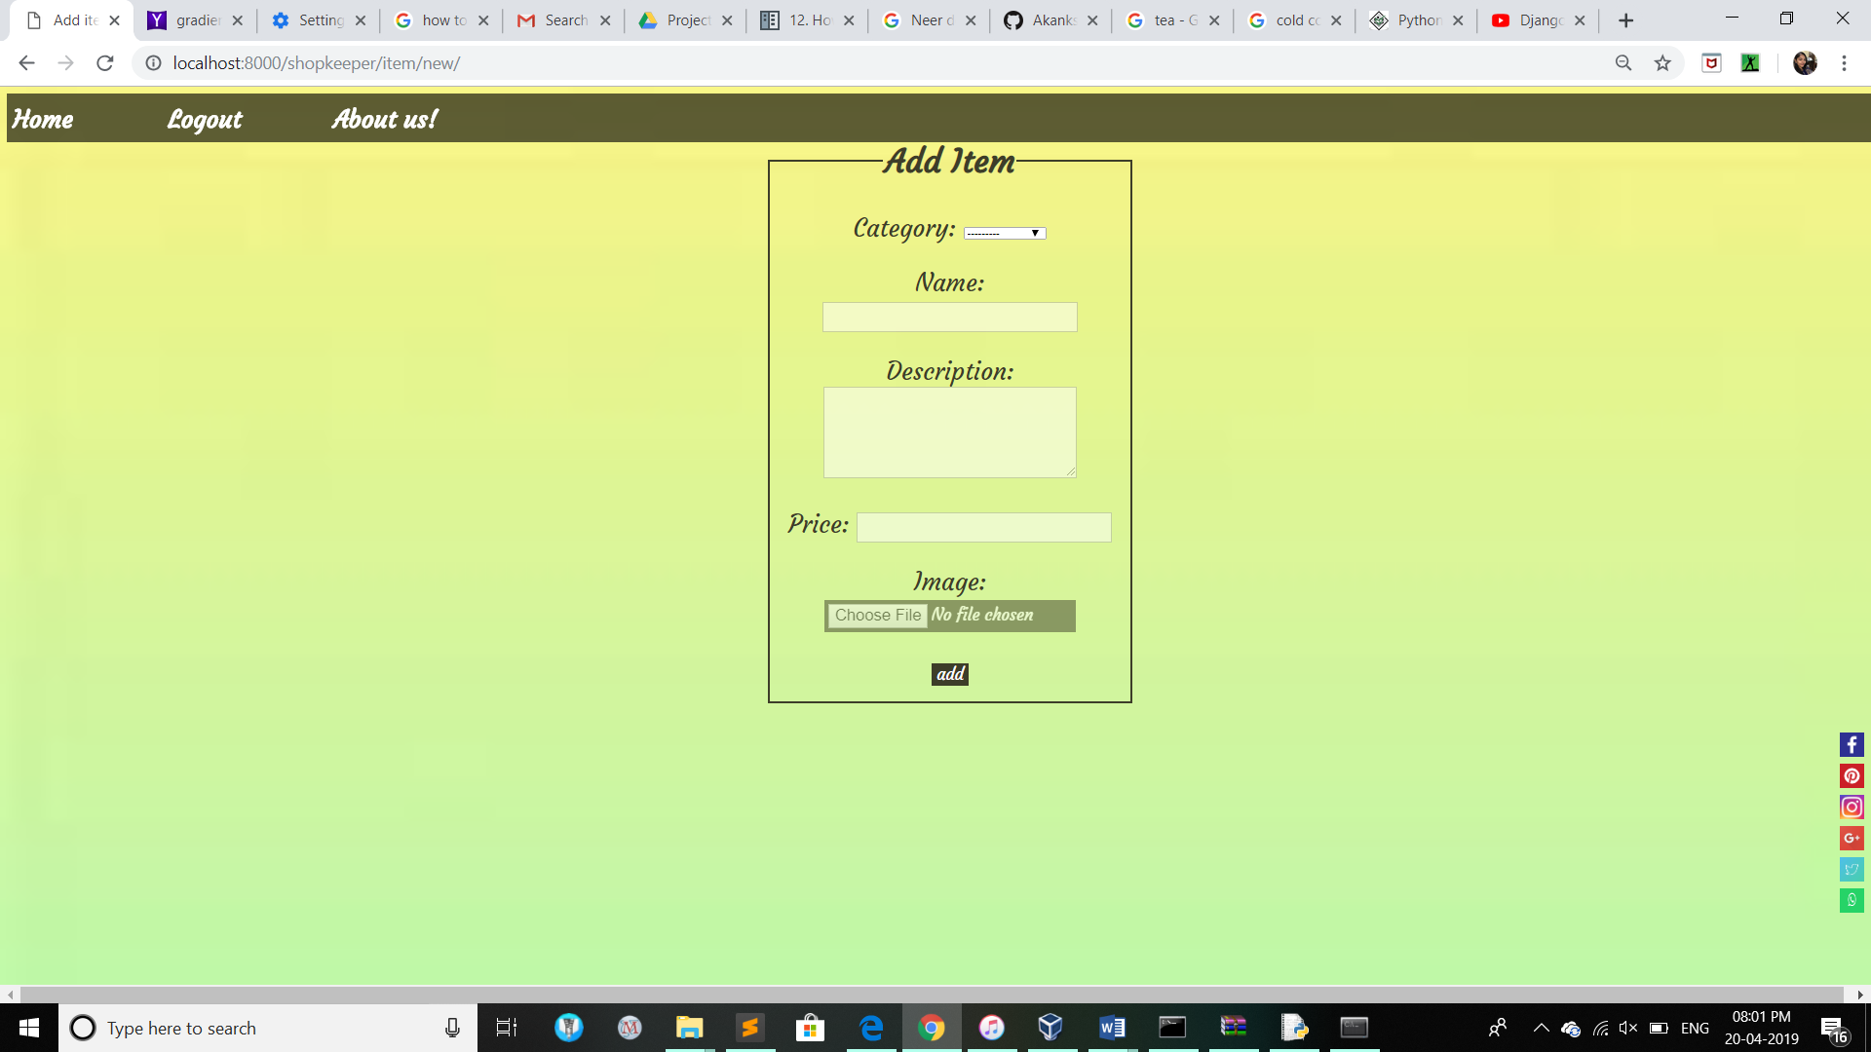
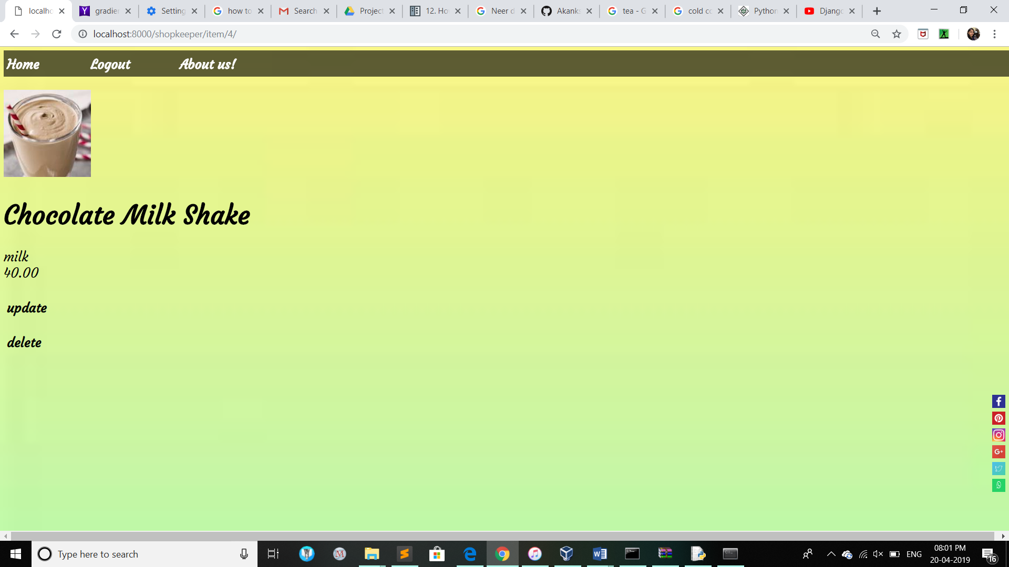
SCREENSHOTS OF THE PROJECT

Slide 11
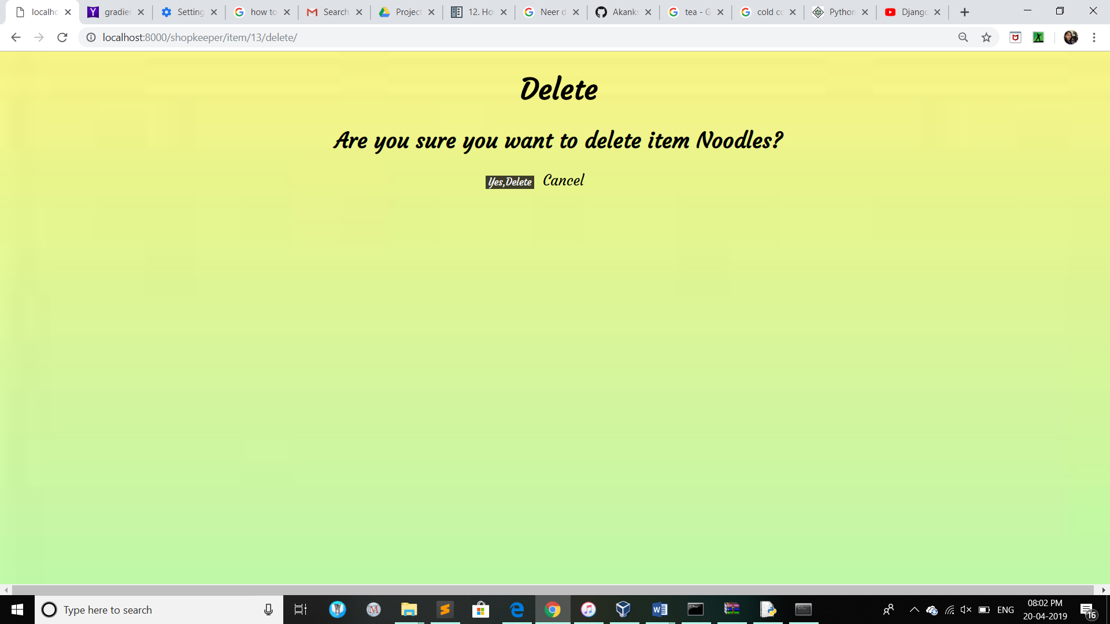
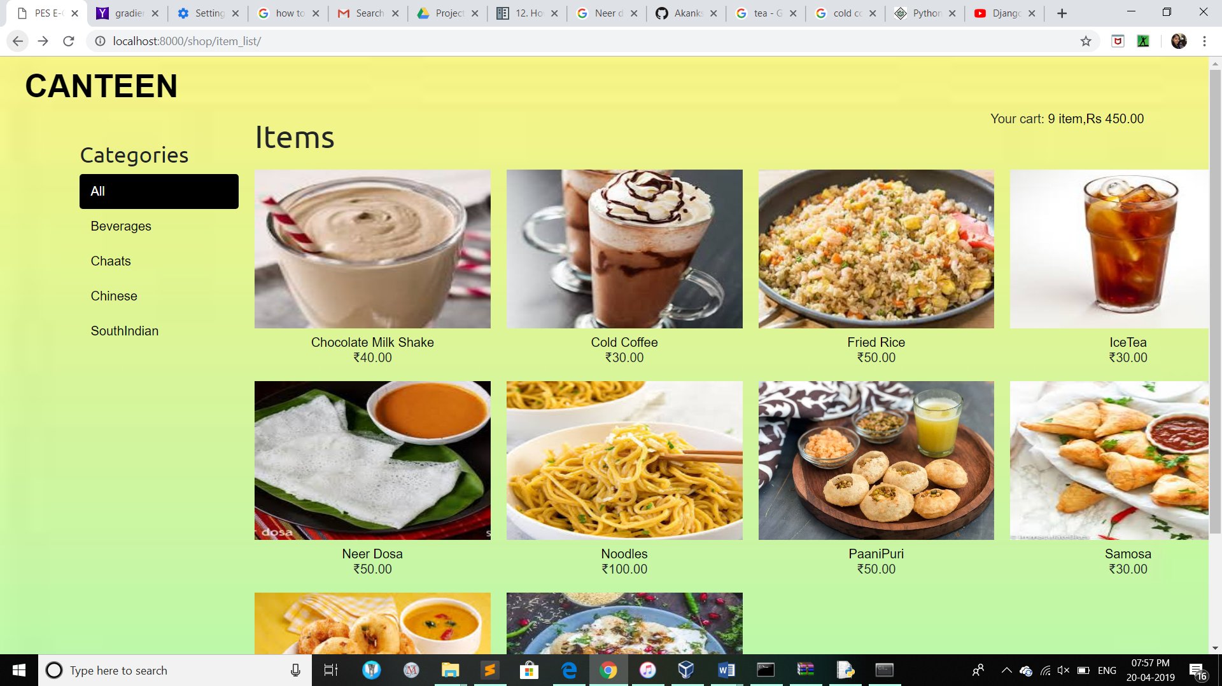
SCREENSHOTS OF THE PROJECT

Slide 12
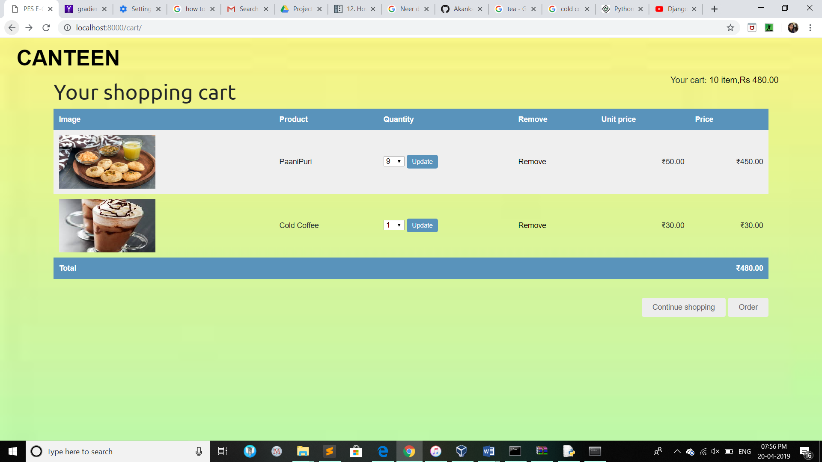
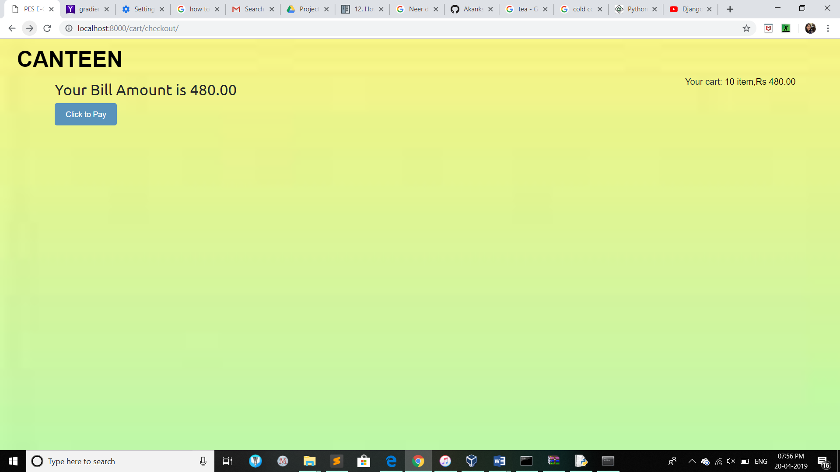
SCREENSHOTS OF THE PROJECT

Slide 13
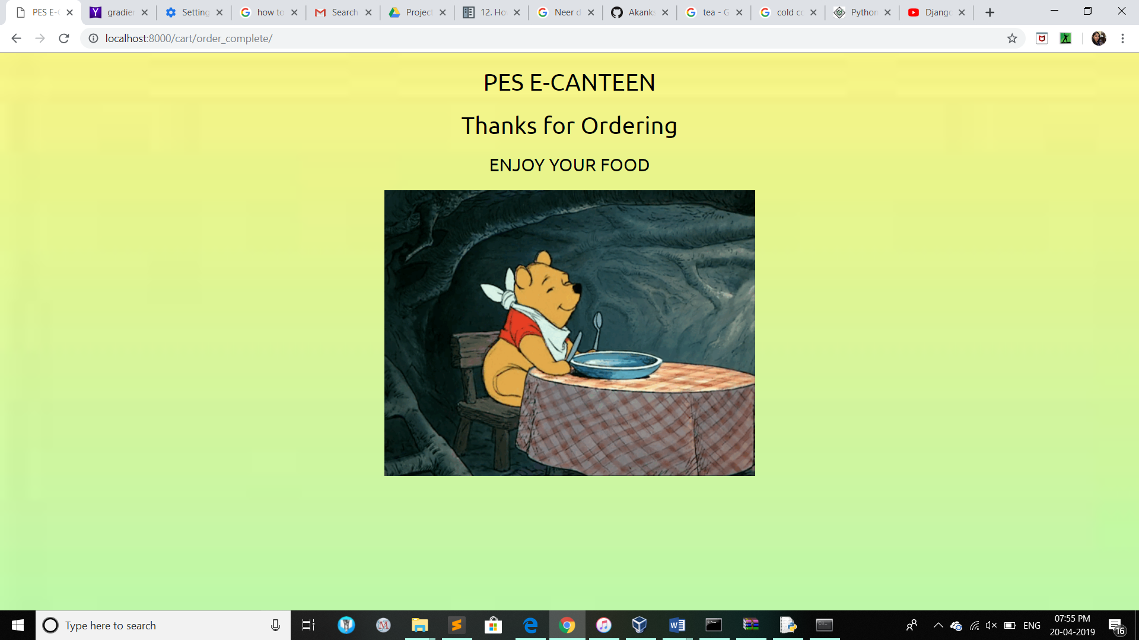
SCREENSHOTS OF THE PROJECT

Slide 14
Contact Information
Akanksha Tonne : PES1201700275 : tonne.akanksha99@gmail.com
Athira AD : PES1201701633 : athiraasha1126@gmail.com
Bhavna A : PES1201700062 : bhavnaaro28@gmail.com

Slide 15
THANK YOU

